Slide 1
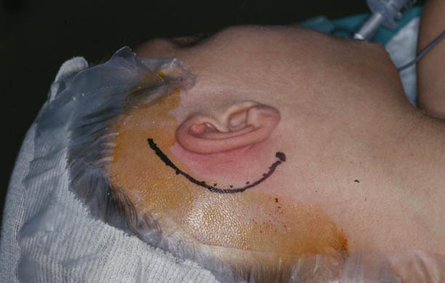
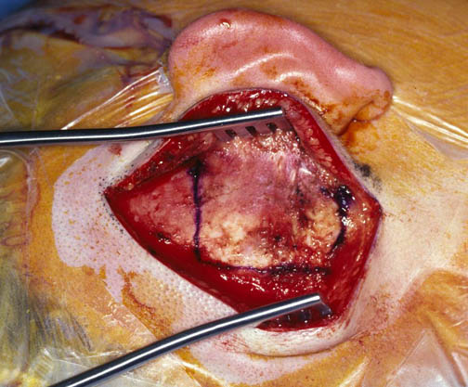
Figure5-1
Exposure
Incision in hairline provides wide access to mastoid cortex
Figure5-2
Large Anterior Based Palva Flap

Slide 2
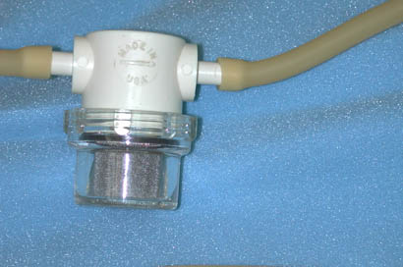
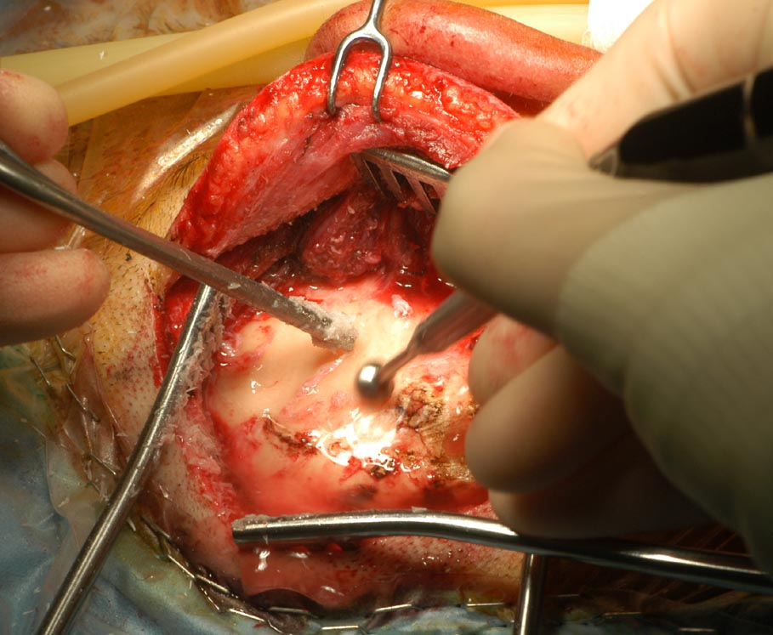
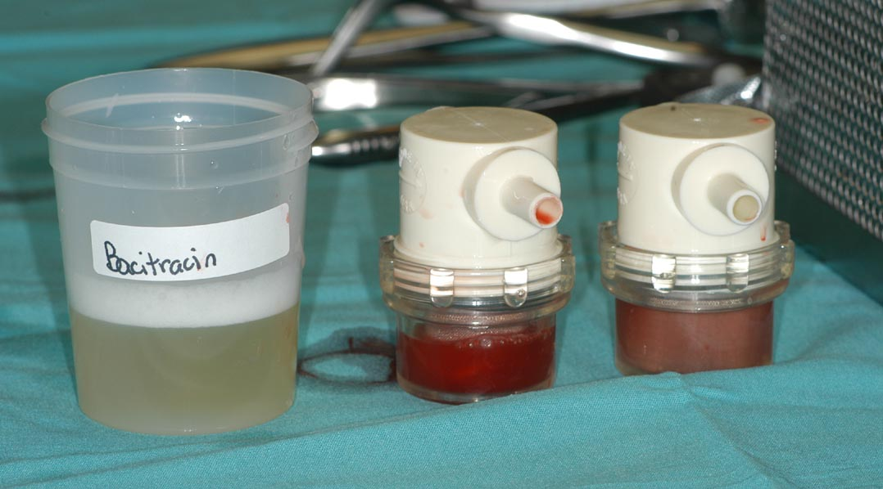
Collect Bone
Pate
Figure 5-3
Stop Collecting Pate When Expose Air Cells

Slide 3
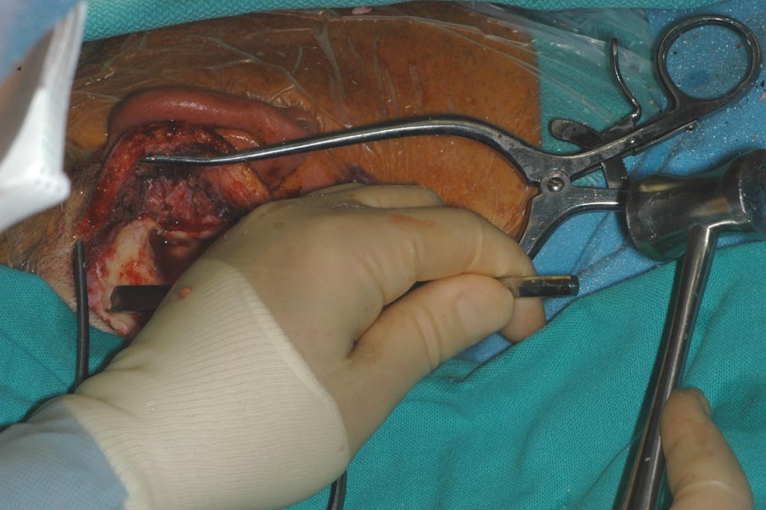
Bone Slices from Outer Cortex and Mastoid Tip
Bone Chips from Cortex

Slide 4
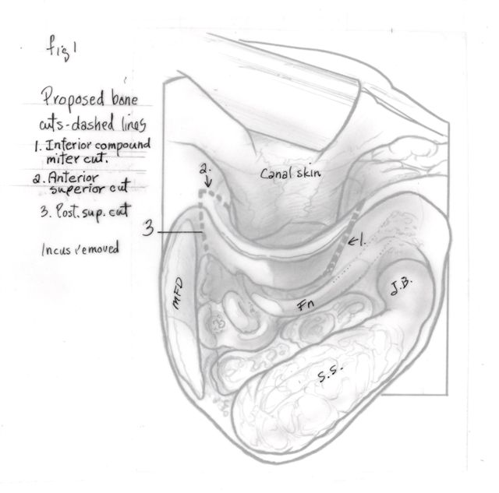
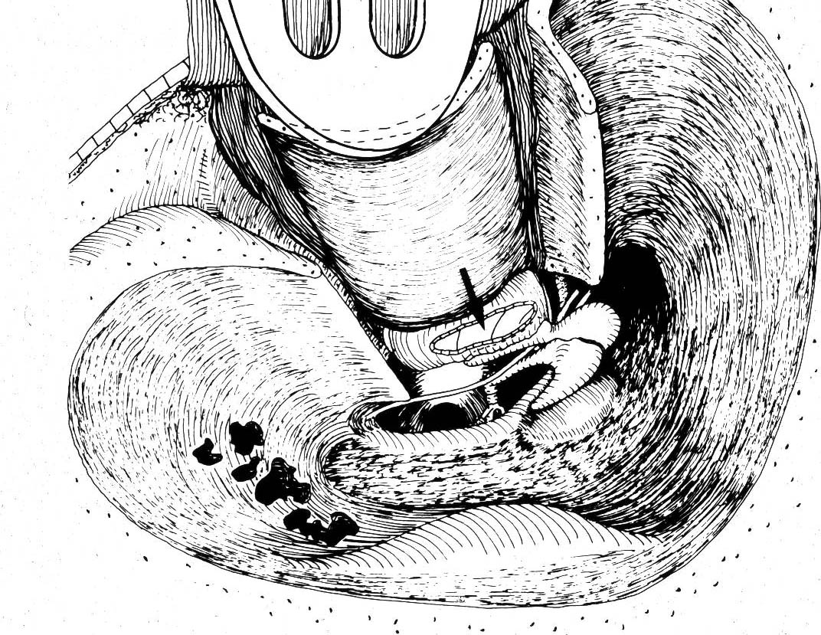
Figure 5-6
Elevate posterior canal wall skin and anulus anterior-
No cuts in canal skin

Slide 5
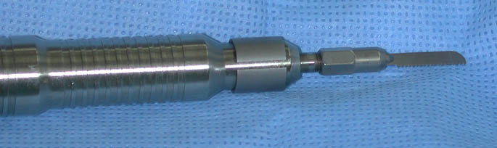
Figure 5-7a
Reciprocating Saw on Otologic Drill
Stryker, Medtronics, BienAir : Special thin blade

Slide 6
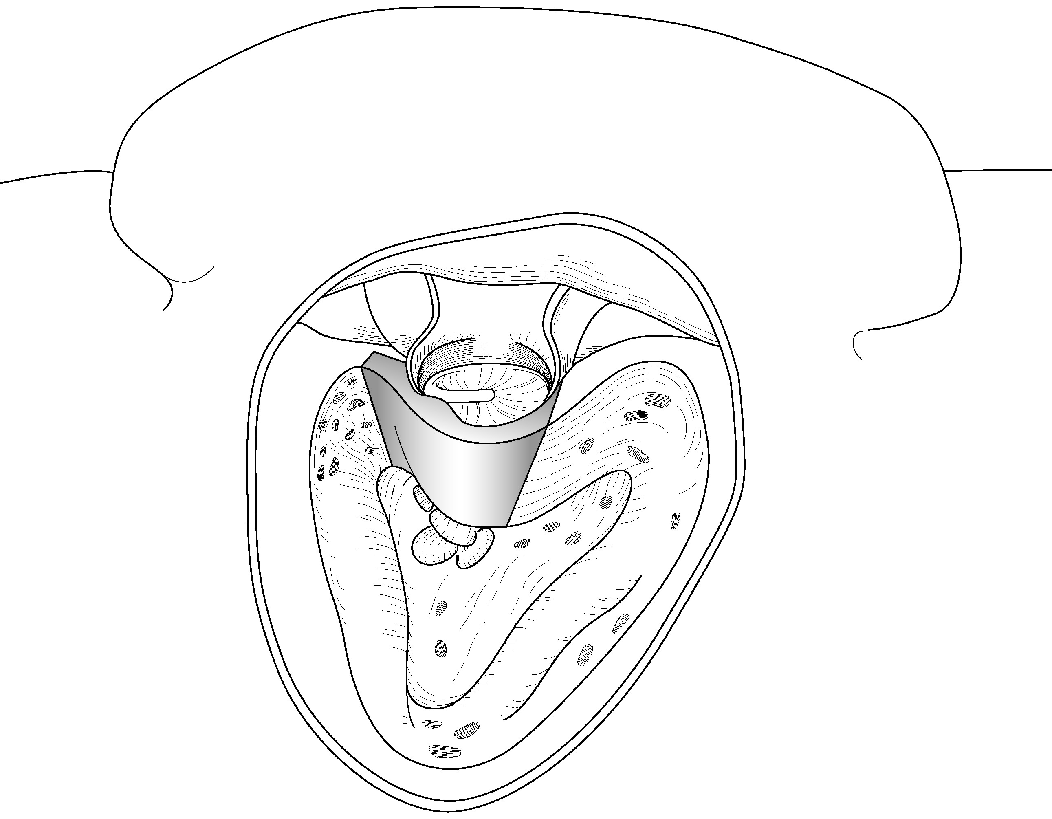
Canal Wall Removal
Figure 5-7b
slant & bevel cut from extended facial recess to inferior floor of canal
Right Angle Cuts
Bevel to prevent Displacement – Posterior to Anterior and Medial to Lateral
“Compound Mitre”

Slide 7
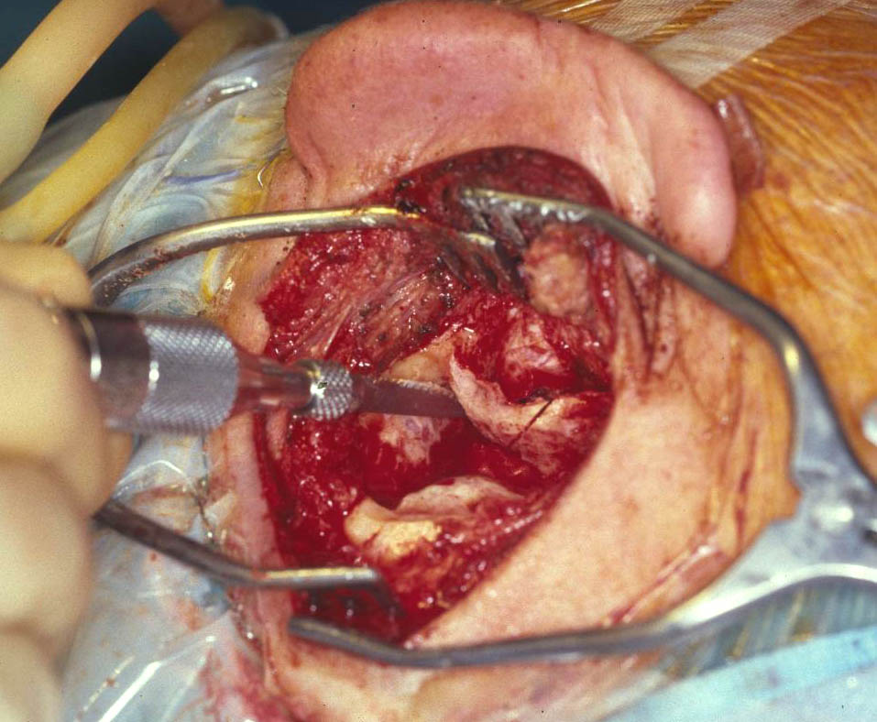
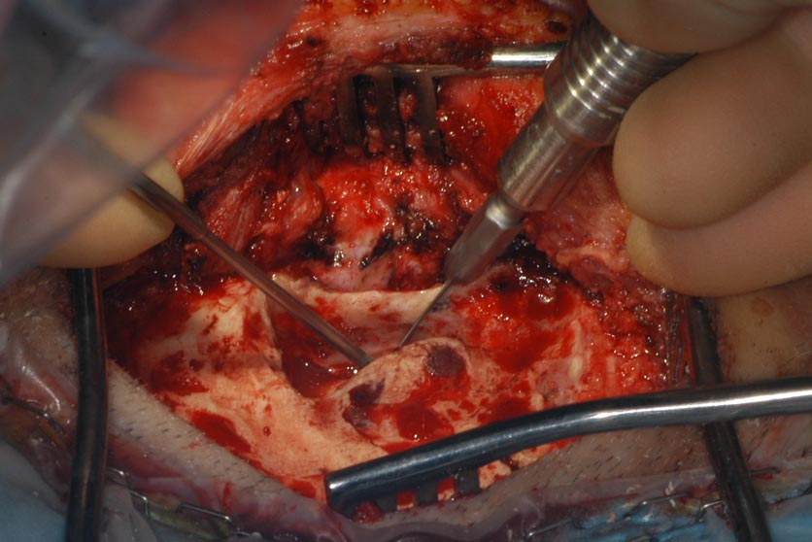
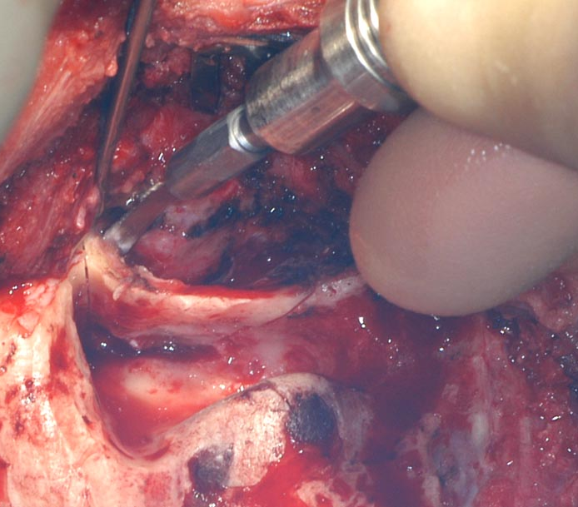
Figure 5-7c
Inferior
Cut
Superior Perpendicular Cut
slant & bevel cut
from extended facial
recess to inferior
floor of canal
Canal Cuts
Posterior Cut

Slide 8
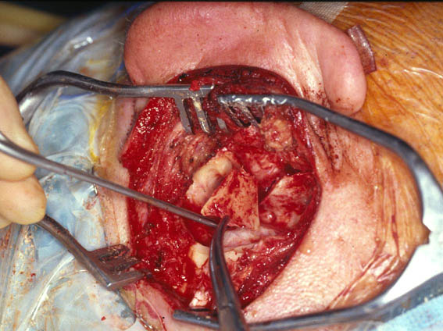
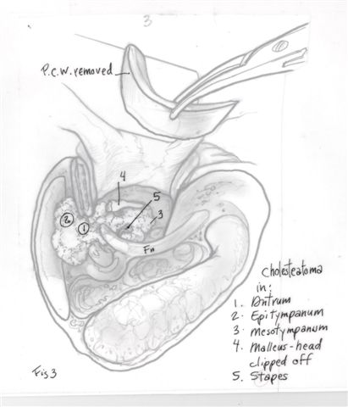
Figure 5-7d
Posterior Canal Removal

Slide 9
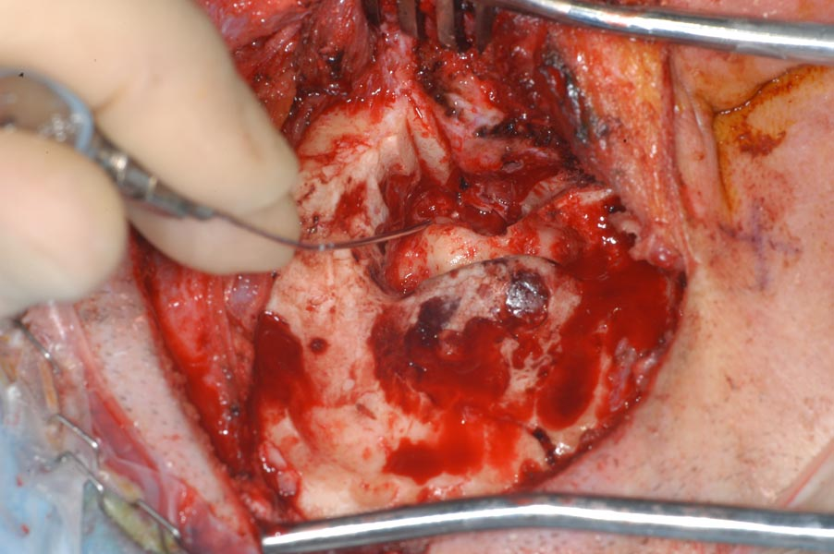
“Open Cavity View”
Figure 5-7e
Canal cut
Canal cut
Exposure of Zygomatic Root and Epitympanum

Slide 10
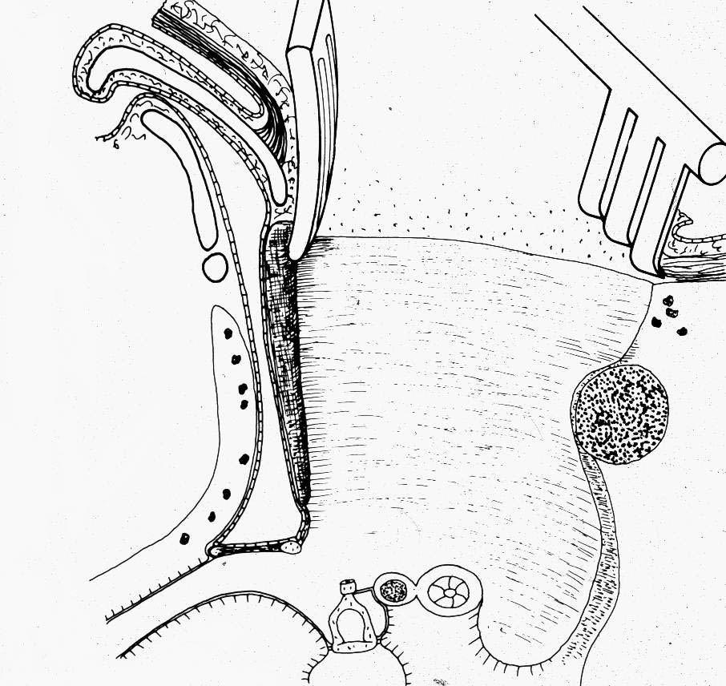
Figure 5-7f
Cut Tensor Tympani Tendon
X

Slide 11
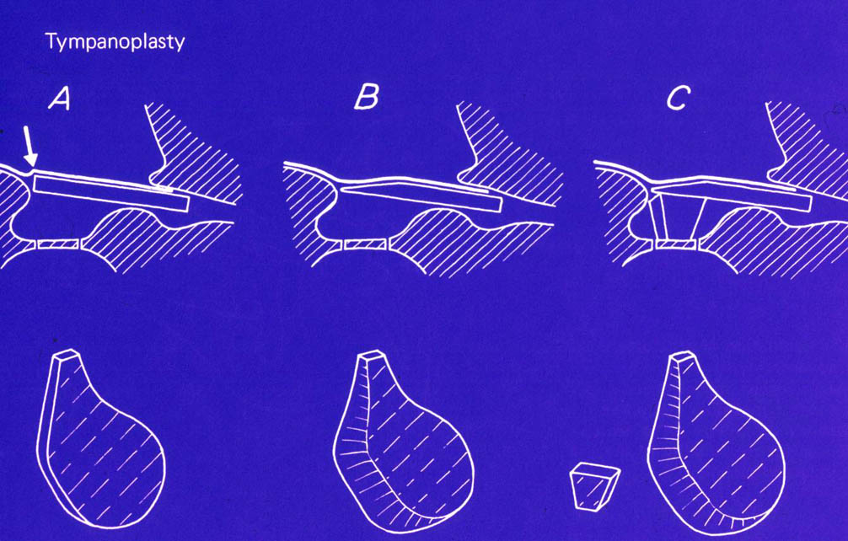
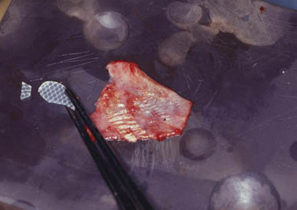
Silastic Middle Ear Spacer (0.40)
Figure 5-9
Spacer for Middle ear
For Oval Window
Temporalis Fascia

Slide 12
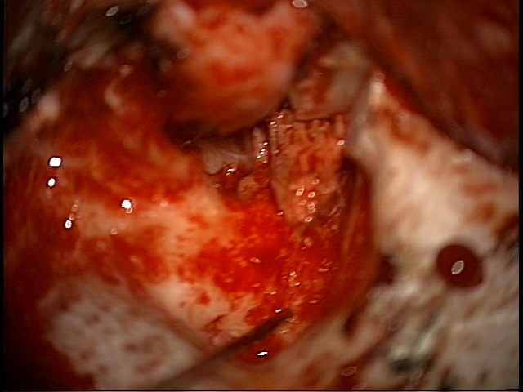
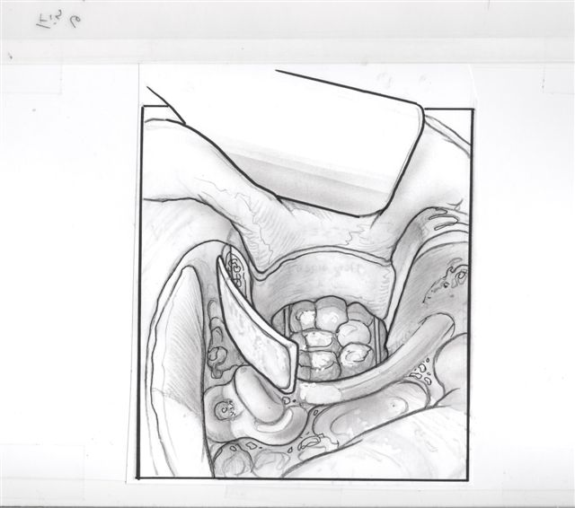
Figure 5-11
Mastoid
Tip Bone
Blocking
Attic
Mastoid tip Bone
Blocking Attic
Anterior to
Zygomatic Root

Slide 13
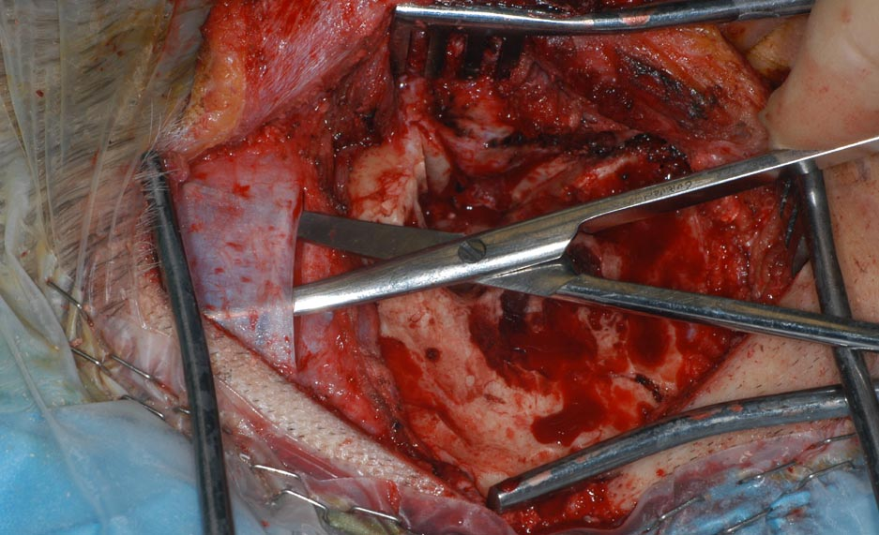
Temporalis Fascia for Underlay Tympanoplasty

Slide 14
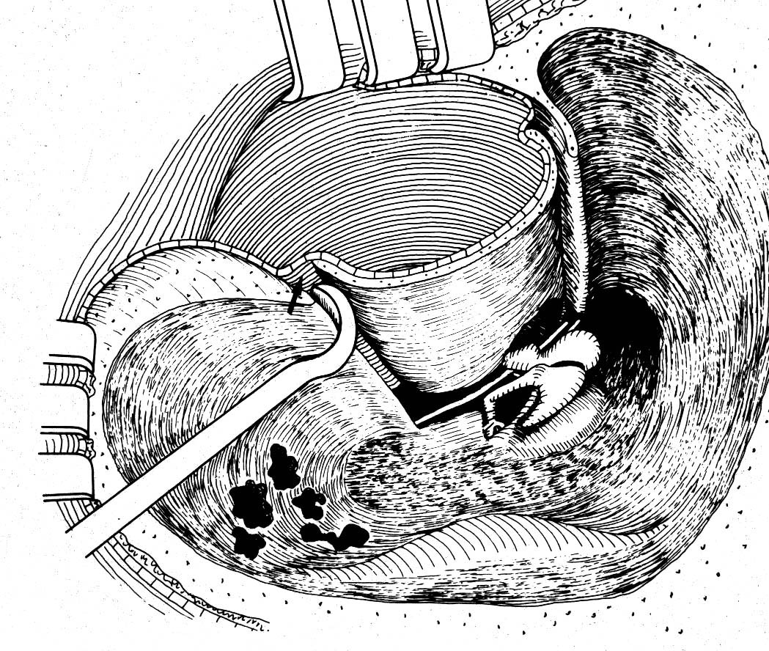
Elevate Canal Wall Skin to Tuck Fascia Graft

Slide 15
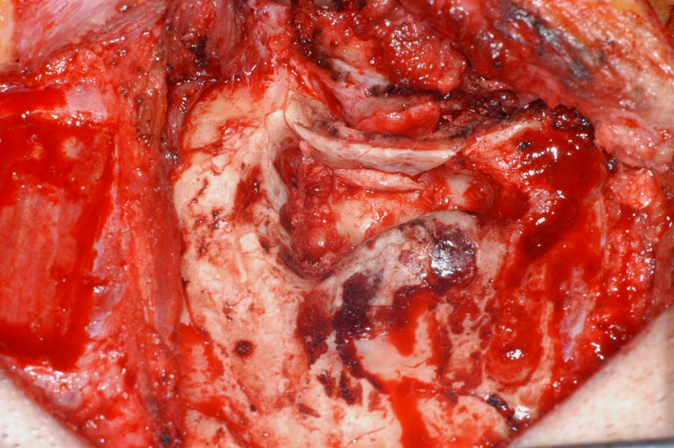
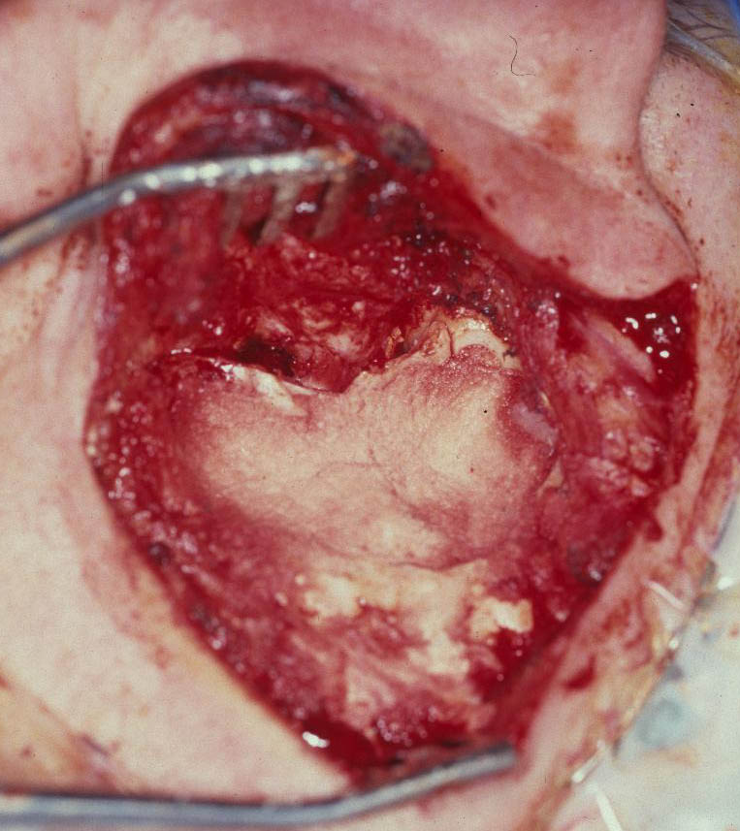
Replace Canal Wall
Figure 5-12
Mastoid Tip bone from Scutum to Facial Ridge
Bone Pate
Bone Chips
Facial Recess
Bone Pate
filling Mastoid

Slide 16
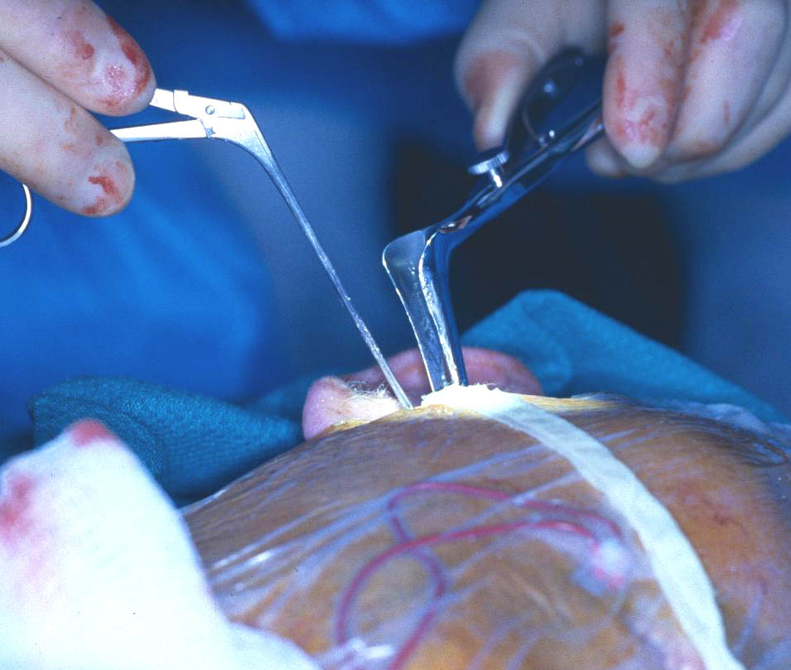
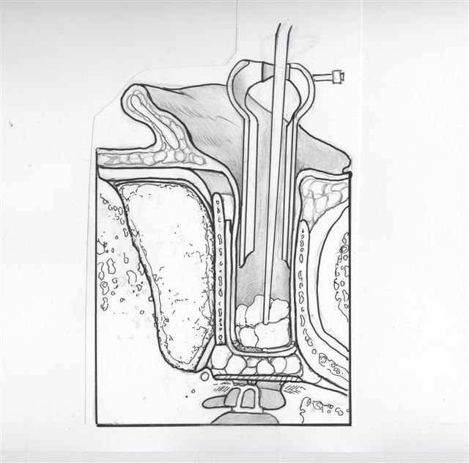
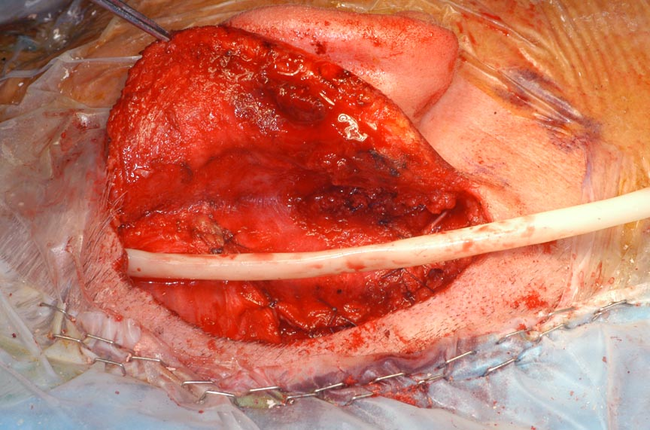
Pack External
Canal
Figure 5-13
Penrose Drain
Superficial to Palva
24-48hrs
Figure 5-14

Slide 17
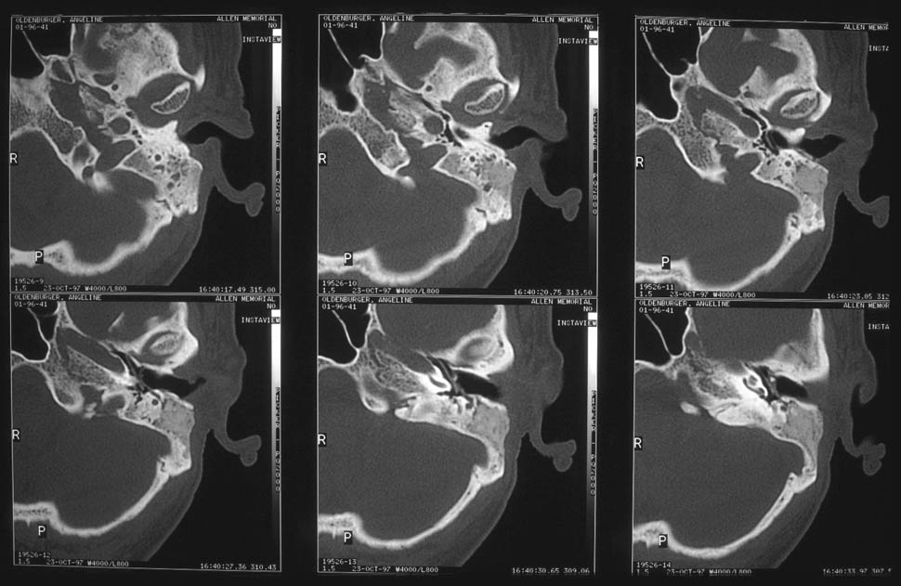
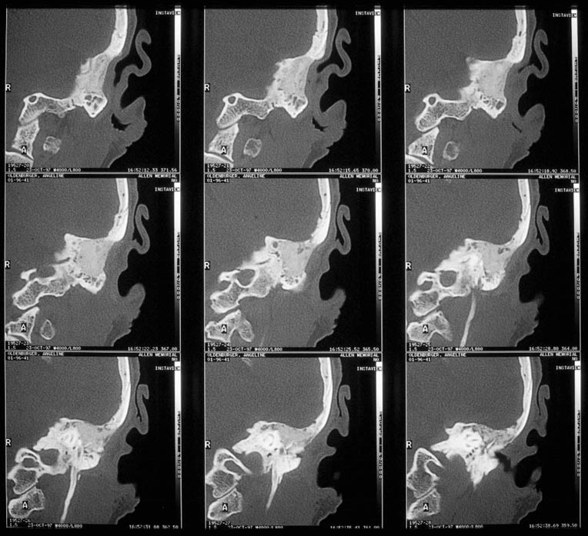
CT Scans of Obliterated Mastoid

