Slide 1

Salivary Stones and Lab Prep
(for sialendoscopy)
Missouri Sialendoscopy Course
Columbia Missouri
April 16, 2015
Henry Hoffman MD MS
3,000+ page handout with videos/photos: search for “Iowa Protocols”
search: “Sialendoscopy Course LSU 2015”

Slide 2
H Hoffman --- Disclosures
-- Consultant to COOK Medical -- research in laryngology, surgical management of salivary disorders and other ENT applications
-- The University of Iowa Research Foundation (UIRF)and Dr. Hoffman filed a provisional patent application
April 11 2013 “Transilluminating Obturator” UIK-04301
-- The University of Iowa Research Foundation and Dr. Hoffman filed a patent application
March 25 2009 (US Patent) and March 19 2010 (International Patent: CT/US2010/027995) “Arytenoid Repositioning Device”
Portions of possible future profits from devices associated with these patents will be disbursed through the UIRF with Henry Hoffman listed as one of the recipients
Missouri Sialendoscopy Course
Columbia, Missouri
April 16, 2015
Henry Hoffman MD MS

Slide 3
Endoscopic Salivary Stone Fragmentation
with Pneumatic Lithotripsy
Henry Hoffman, MD, Jack Kolenda MD, Rohan R Walvekar MD
R Walvekar MD
Conclusion:
Modification to the evolving technology of intracorporeal
pneumatic management of nephrolithiasis was successfully
applied in an ex vivo model to manage sialolithiasis.
Take Home Message:
We should copy, modify, and apply that which has been
successfully used by Urologists.

Slide 4
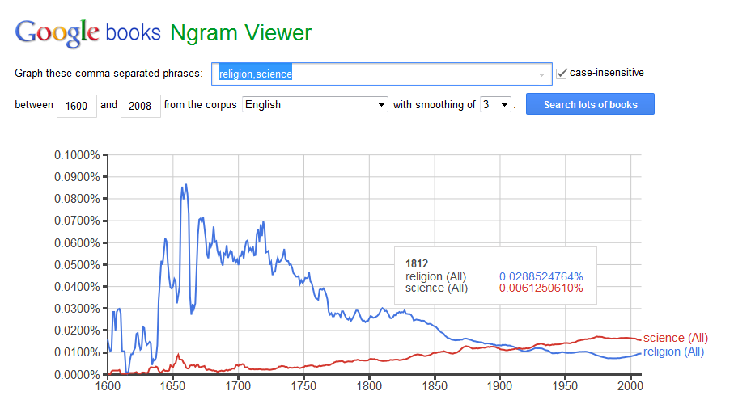

Slide 5
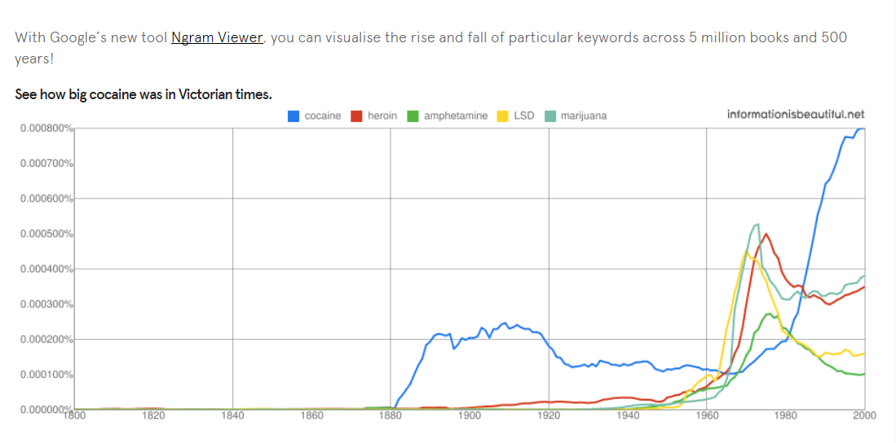
“Today it is hard to believe, but in early- and mid-Victorian Britain
it was possible to walk into a chemist's shop and buy without prescription
laudanum, cocaine, and even arsenic. Opium preparations were also sold
freely in towns on market halls and in the countryside by travelling hawkers.
Victorian Drug Use” http://www.victorianweb.org/victorian/science/addiction/addiction2.html

Slide 6
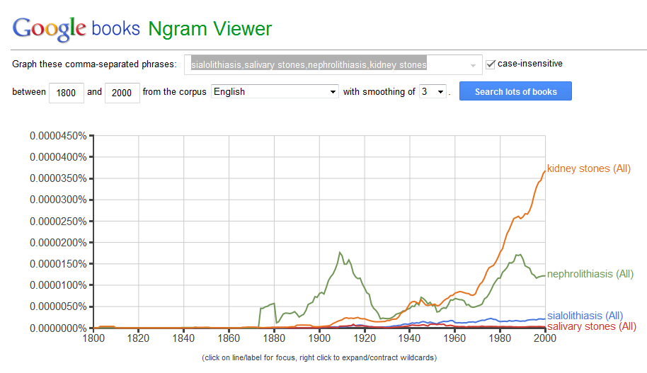

Slide 7
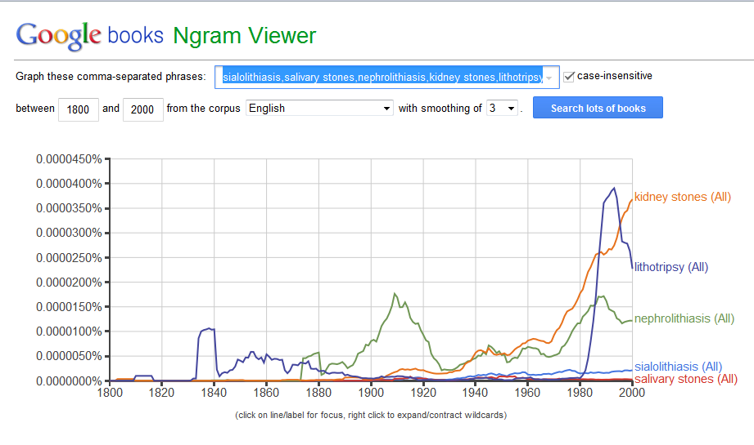

Slide 8
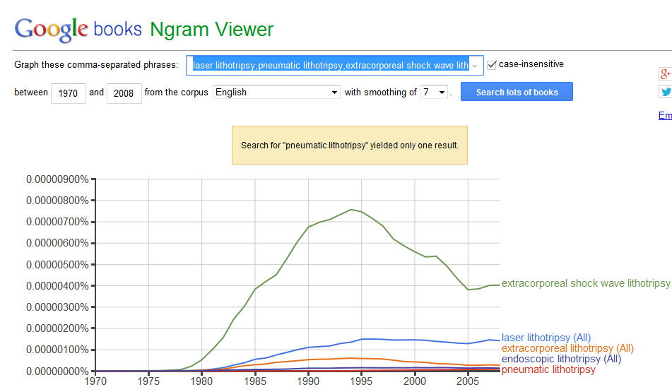

Slide 9
Incidence/Prevalence of Stones
Nephrolithiasis
Sialolithiasis
11.7% prevalence by age 70 (a)
10% lifetime risk in U.S. ( and increasing) (b)
Est. annual cost of 5.3 billion in US (c)
Lifetime risk 13%(male) 7%(female) (d)
1 per 10-20,000 population per year (1)
1 per 15-30,000 population per year (2)
1 per 300,000 population per year (3) 1.2% Prevalence in postmortem study (0.45% symptomatic prevalence) (4)
lifetime risk of 1-2%
0.1 to 1.0% of adult population
(a) Brenner and Rector’s the Kidney Ch 39
(b) Stamatelou KK, Francis ME, Jones CA et al: Time
trends in reported prevalence of kidney stones in
the United States: 1976–1994. Kidney Int 2003;
63:1817
(c) Saigal CS et al Urologic Disease in America Project:
Direct and indirect costs of nephrolithiasis …
Kidney Int 2005;68:pp1808-1814
d. Preminger GM, Tiselius HG, Assimos DG, et al.
Guideline for the management of ureteral calculi.
J Urol 2007 2007:187:2418-34
Marchal F, Dulguerov P. Sialolithiasis management: the state of the art.Arch Otolaryngol Head Neck Surg 2003;129: 951–956.
Escudier MP, McGurkM:Symptomatic sialoadenitis and sialolithiasis in the English population: an estimate of the cost of hospital treatment. Br Dent J 1999;186:463-466
Rauch from Rice DH> chronic inflammatory disorders of the salivary glands. Otolaryngol Clin North Am. 1999;32:813-818
McGurk M, Escudier MP, Brown JE. Modern management of salivary calculi. Br. J. Surg. 2005;92:107-112

Slide 10
Kidney Stone Composition
Calcium Oxalate and Calcium Phosphate | Calcium Phosphate | Uric Acid | Calcium oxalate | Calcium Oxalate and Uric acid | Cystine | Struvite | Number of stones
34 | 5 | 5 | 33 | 1 | 3 | 19 | 1000 Prien
30 | 21 | 13 | 27 | — | 3 | 15 | 155 Mellick
44 | 8 | 2 | 15 | 2 | 1 | 28 | 460 Lagergren
46 | 8 | 3 | 15 | — | 3 | 25 | 243 Nordin

Slide 11
Salivary Stone Mineral Composition
Calcium phosphate | Hydroxyl apatite (HA) only | Hydroxyl apatite & Whitlockite (WI) | Hydroxyl apatite & Brushite (BR) | Number of stones
100% (23) All from SMG ‘intra-glandular were all HA only’ | 52% (12) 12 (HA only) | 43% (10) 10 (HA+WI) | 4%(1) 1 (HA + BR) | 23 Teymoortash (2003)
100% (19) | 68% ()13 | 6 |  | 19 Anneroth (1975)
When a stone is available, clinicians should obtain a stone analysis at least once. ( Clinical Principle)
Stone composition of uric acid, cystine or struvite implicates specific metabolic or genetic abnormalities, and knowledge of stone composition may help direct preventive measures. Journal of Urology 192, Issue 2 2014 Pearle M et al “Medical Management of Kidney Stones: AUA Guideline”
Teymoortash A, Buck P, Jepsen H, Wernereymoranra: Sialolith crystals localized intraglandularly
and in the Wharton’s duct of the human submandibular gland: an X-ray diffraction analysis
Archives of Oral Biology (2003)48,233-236
Anneroth G, Eneroth CM, Isacsson G: Crystalline structure of salviary calculi. A microradiographic
and microdiffractometric study
J Oral Pathol 1975 Nov;4(5):266-72

Slide 12
Definitions
Calculus: a hard, stone-like concretion that forms in the body usually made from
mineral salts ex: dental calculus, kidney stones, salivary stones
Lithogenesis: formation of a calculus
Mineral salts: apatite … whitlockite and brushite
Lithotripsy is a procedure that uses shock waves to break up stones in the kidney,
bladder, or ureter (tube that carries urine from your kidneys to your bladder).
After the procedure, the tiny pieces of stones pass out of the body in your urine.
Pneumatics is a section of technology that deals with the study and application of
pressurized gas to produce mechanical motion. Pneumatic systems used extensively
in industry are commonly powered by compressed air or compressed inert gases
Picture
removed
Micro CT scan of sialolith
organic nucleus surround by
laminated layers of organic
and inorganic substances
British Dental Journal 217, E23 (2014)
Published on-line

Slide 13
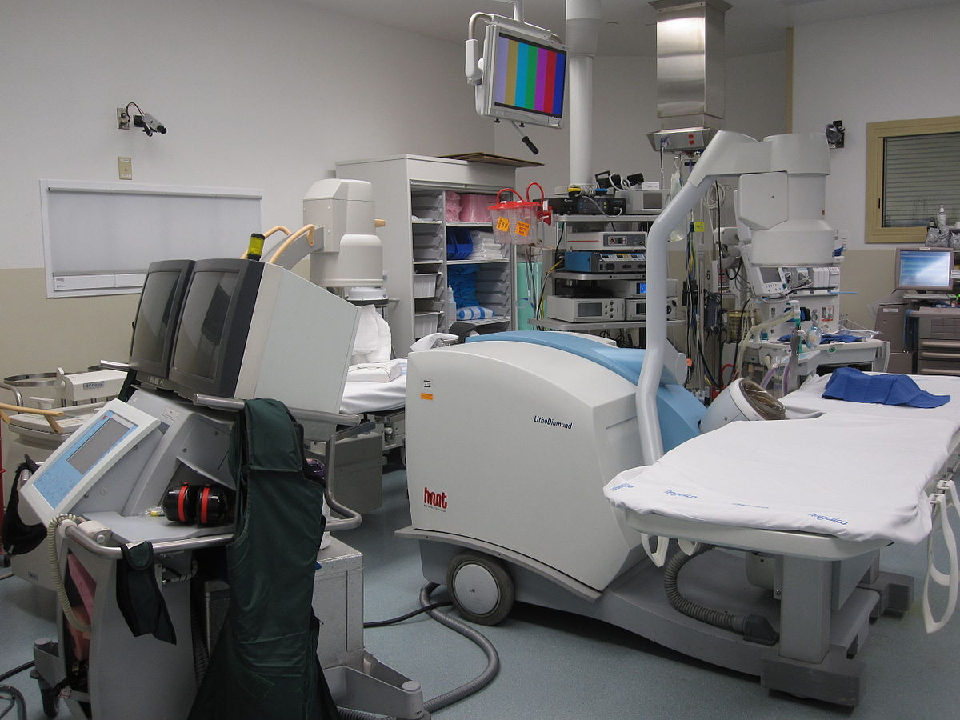
Extracorporeal shock wave lithotripsy: high energy shock waves are passed through the body and to fragment kidney stones – ideally to a small size permitting them to pass from the body along with the urine. Can be administered in tub of water or with the patient lying on a soft cushion through which the waves pass. ~ 1-2 thousand shock waves are used for a treatment that takes 45-60 minutes.
Photo by DiverDave - Own work.
Licensed under CC BY-SA 3.0
via Wikimedia Commons –
http://commons.wikimedia.org/wiki/File:Lithotriptor_machine.jpg#/media/File:Lithotriptor_machine.jpg

Slide 14
Submandibular (N=60) and Parotid (N=34)
small to medium size
Shock waves disconnect the stone from the ductal wall
and reduce stone volume and provide
revascularization angiogenesis
Picture removed
Picture removed
After External Lithotripsy:
32% total elimination of stone
29% sialendoscopic assistance
39% combined with external
U/S and endoscopy assist in locating the stone
The endoscope irrigates and inflates gland
(saline and @% lidocaine)
External lithotripsy applide
low-energy levels up to 130 atm
1,000 to 1,5000 shock waves per session
3 sessions administered at one month intervals
Low energy – therefore not painful, no anesthesia
Photo depicts sialendoscope intraorally and a miniature external lithotripter –Nahlieli O, Shacham R, and Zaguir A: Combined External Lithotripsy and Endoscopic Techniques for Advanced Sialolithiasis Cases J Oral Maxillofac Surg 68:347-353, 2010

Slide 15
Pneumatic Lithotripsy vs Laser Lithotripsy
Pneumatic lithotripsy will transmit mechanical energy via a rigid probe on the stone
Prospective Randomized Trial Comparing
Pneumatic Lithotripsy and Holmium Laser
For Management of Middle and Distal Ureteral Calculi
J of Endourology 2014 Li et al
Three-year study of 9482 pts ending 2012
Stone free rate equal after 3 months
Operative time shorter for laser
  Laser group = 28 minutes
  Pneumatic = 41 minutes
Higher stricture rate (p=0.02) with laser
Pneumatic versus laser ureteroscopic
lithotripsy: a comparison of initial
outcomes and cost
Int Urol Nephrol (2014) Demir et al
Retrospective study of 187 patients
Treated with either holmium laser
($1,350 per probe) or pneumatic
Device ($60 per probe)
Laser more expensive but more effective
Higher stricture and perforation rate
  with pneumatic device
3. Concept of ‘retropulsion’ -- less with laser
Salivary Laser Issues
1. Special oral protection - +/- laser tube
2. Extra nurse (‘laser nurse’)
3. Extra set-up time
4. Eye protection (personnel, patient)
5. Risk of laser fire

Slide 16
Email I received two weeks ago:
From: xxxxxxx
Sent: Wednesday, March 04, 2015 5:52 AM
To: Hoffman, Henry
Subject: RE: HH surgery for 03-04-2015 (Team 5 updated 12162014 list)
Dr. Hoffman,
They moved your sialendoscopy to be the 2nd case in room 28. I need to know if you need
holmium yag laser for this case as this room does not have the plug in to accommodate
that laser.
Thanks,
xxx

Slide 17
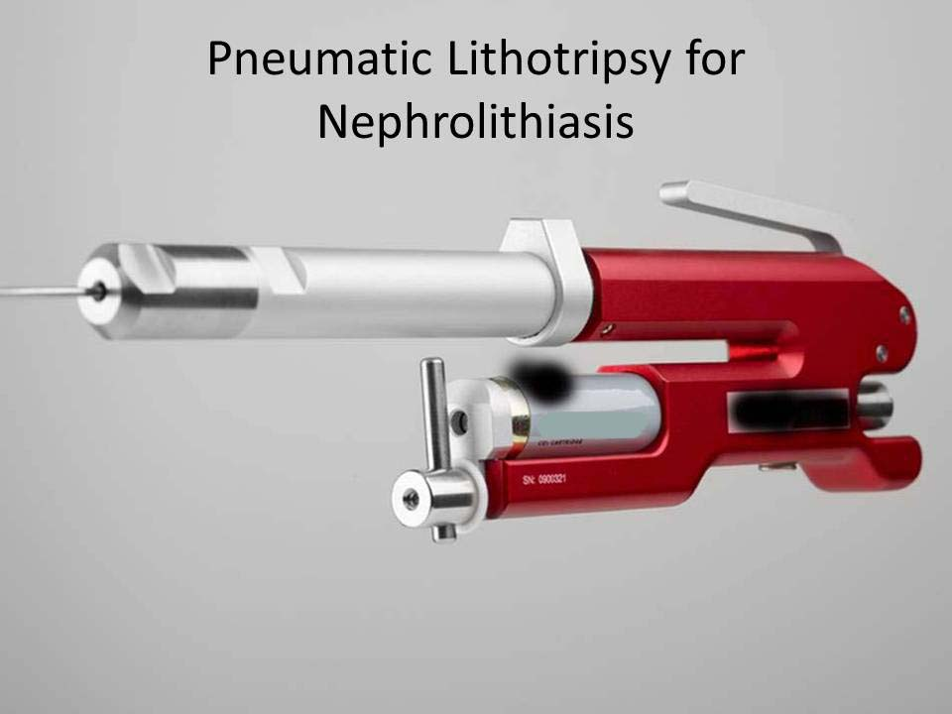
Pneumatic Lithotripsy for
Sialolithiasis

Slide 18
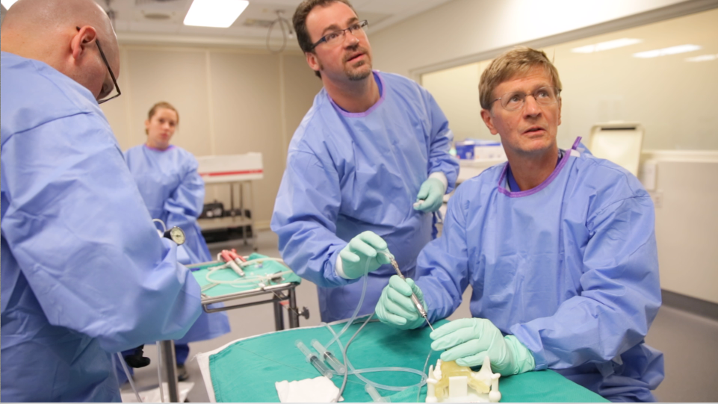
Endoscopic Salivary Stone Fragmentation with Pneumatic Lithotripsy
Henry Hoffman, MD, Jack Kolenda MD, Rohan R Walvekar MD
Feasibility of stone Fragmentation with Pneumatic Lithotripsy (StonebreakerTM)
in a live porcine model
Rohan R Walvekar, MD*; Jack Kolenda, MD; Henry Hoffman, MD

Slide 19
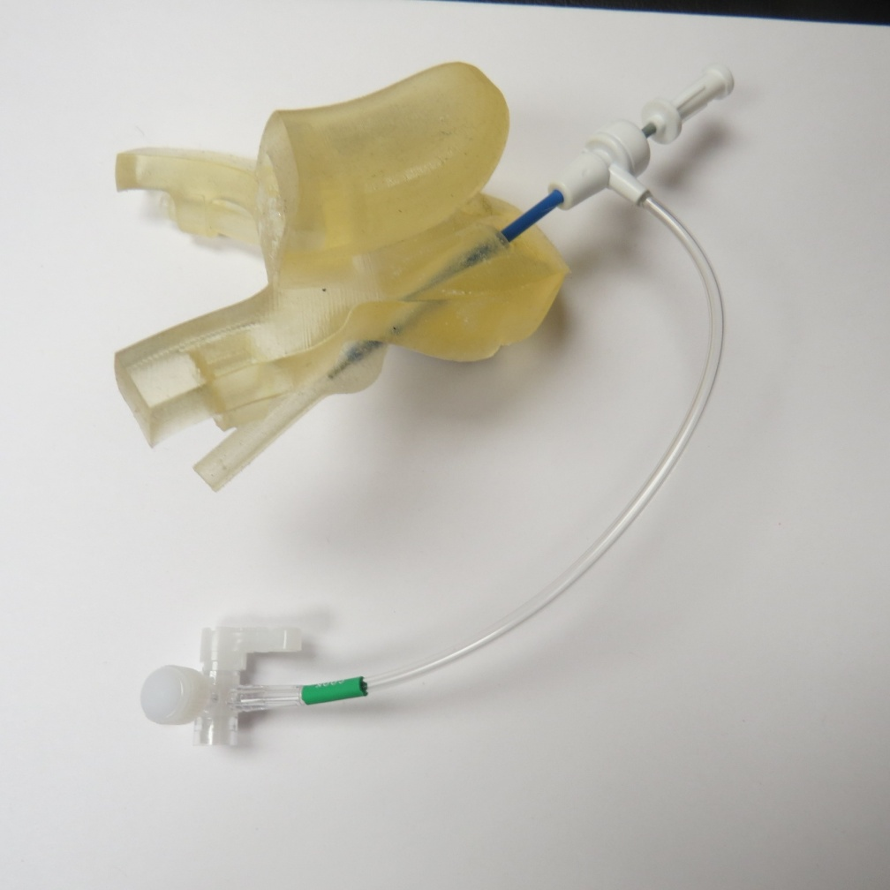
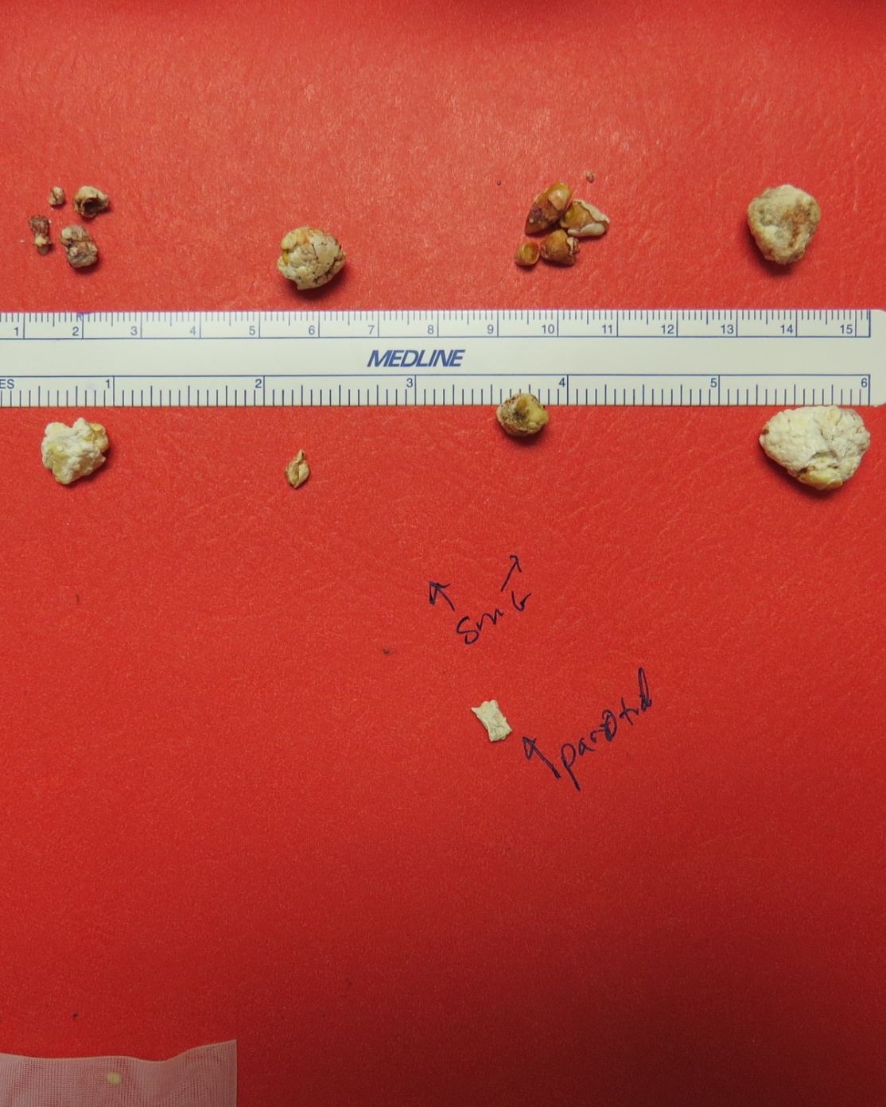
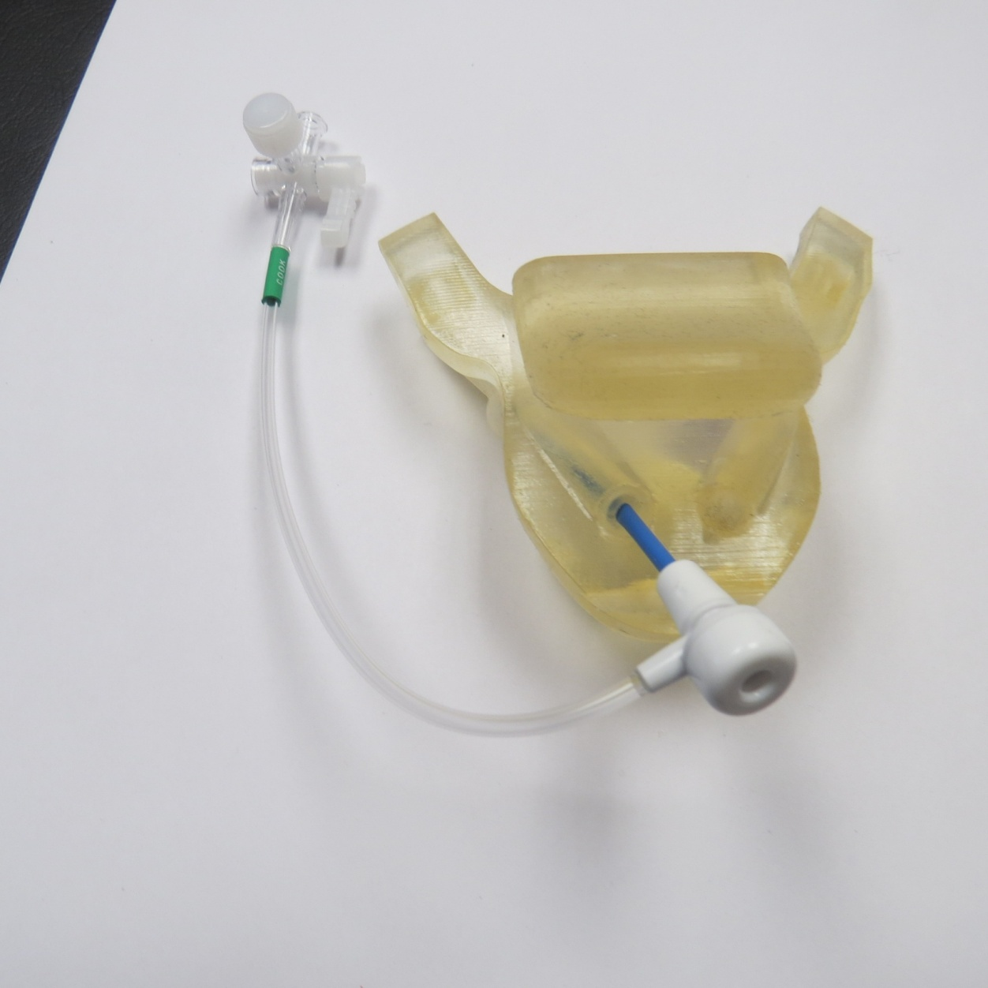
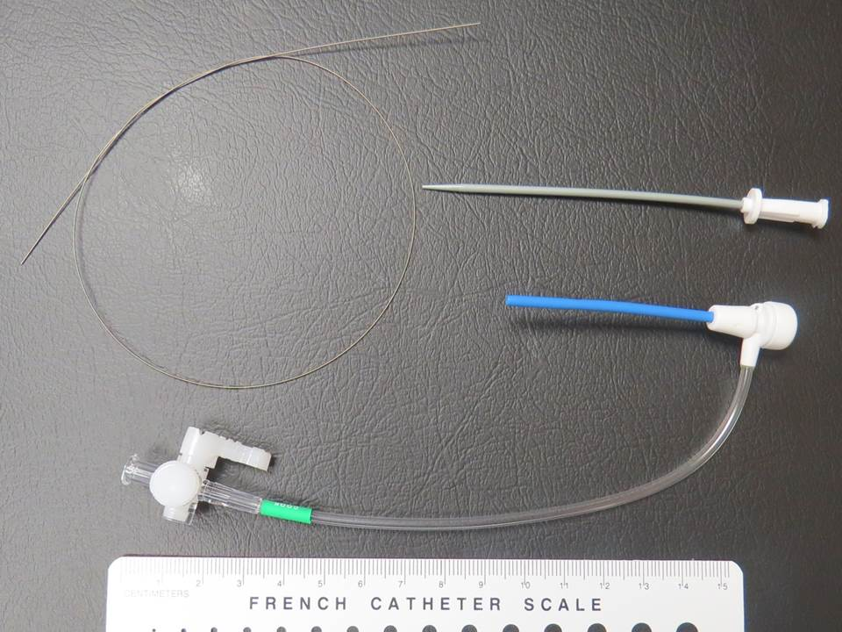

Slide 20
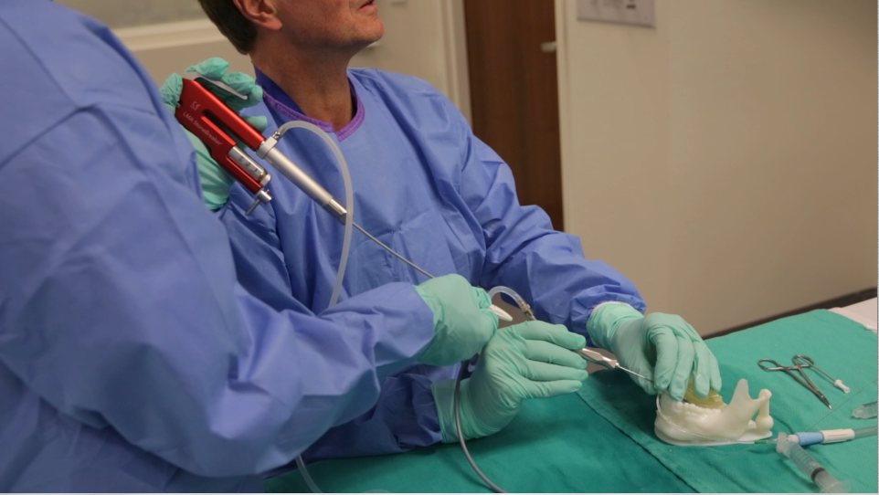
A flexible nitanal contact probe adapted to the Stonebreaker™ urologic CO2 gas-driven hand-held pneumatic lithotripser was deployed through a sialendoscope to disrupt 8 parotid and submandbular stones embedded in separate 3-D printed plastic models of the mouth and submandibular glands. Simulation included endoscopic removal of small stone fragments by standard basket retrieval supplement by irrigation and suction through a salivary duct introducer system.

Slide 21
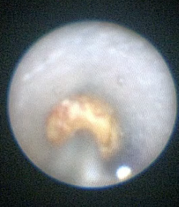
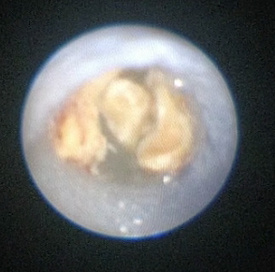
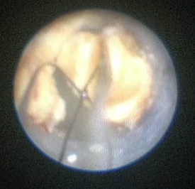
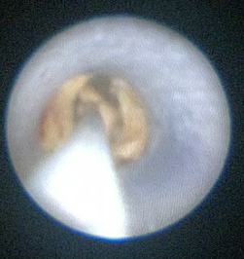
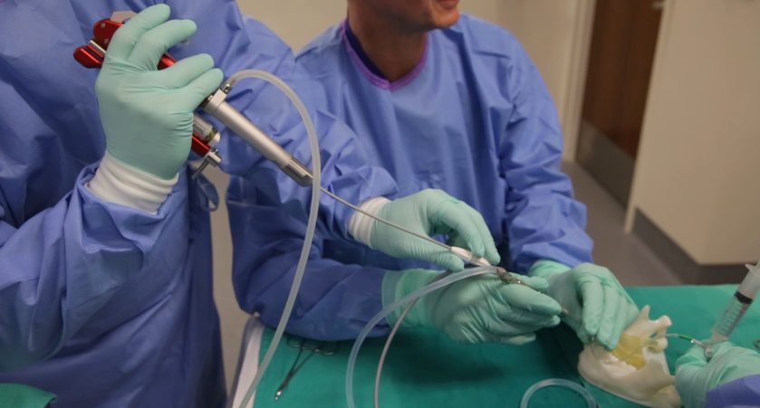
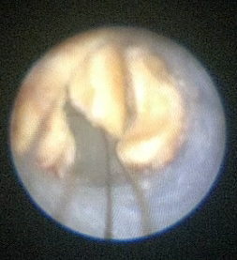
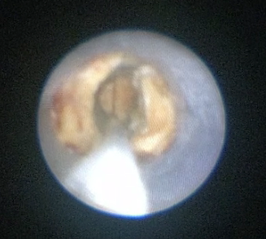
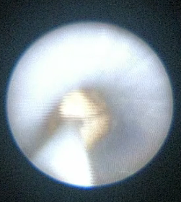
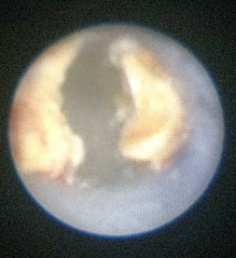
Use of CO2 cartridge powered
pneumatic lithotripsy to fragment stone with
central portion removed with basket

Slide 22
Endoscopic Salivary Stone Fragmentation
with Pneumatic Lithotripsy
Henry Hoffman, MD, Jack Kolenda MD, Rohan R Walvekar MD
R Walvekar MD
Correlations were made between stone appearance, volume, and density with
the duration of the procedures and number of pneumatic pulses required
to completely disrupt and remove stone fragments.
Results
Among the seven stones fragmented sufficiently to permit full endoscopic removal,
the average procedure time (32 minutes) and the average number of
pneumatic pulses (98) correlated with stone density (range 0.4 to 1.5 g/ml)
and stone volume (0.05 to 0.4 ml).
One stone was sufficiently resistant to fragmentation as to prevent successful removal.
Conclusion:
Modification to the evolving technology of intracorporeal
pneumatic management of nephrolithiasis was successfully
applied in an ex vivo model to manage sialolithiasis.

Slide 23
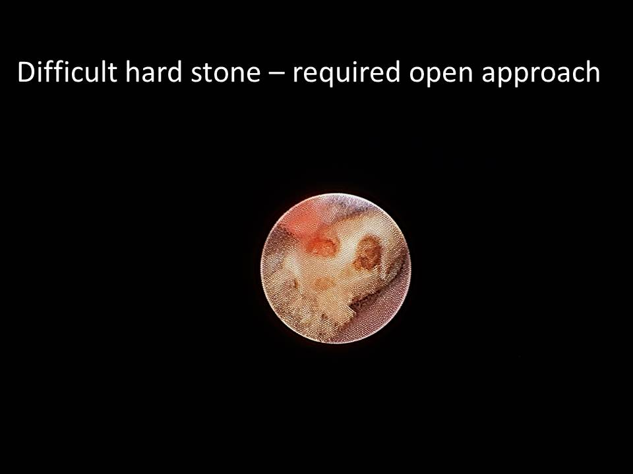

Slide 24
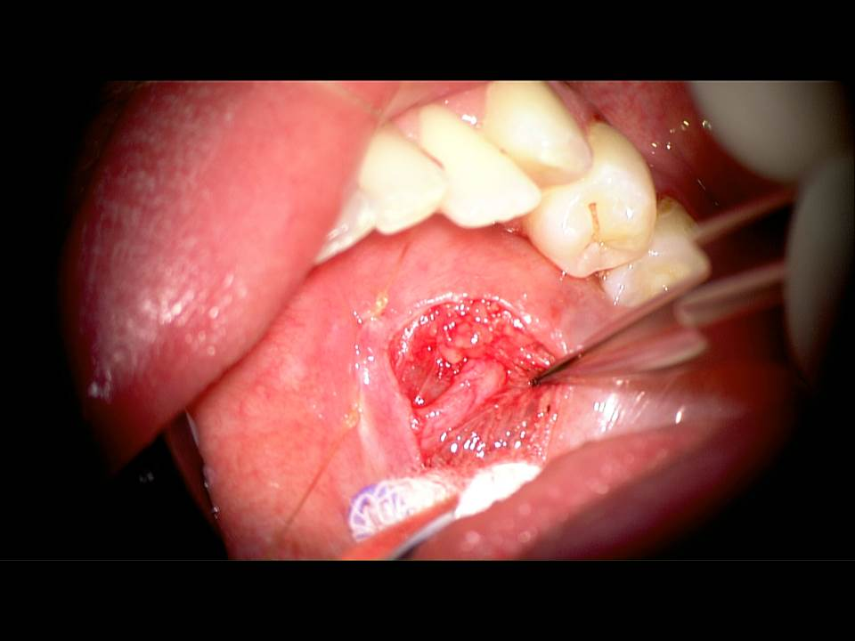

Slide 25
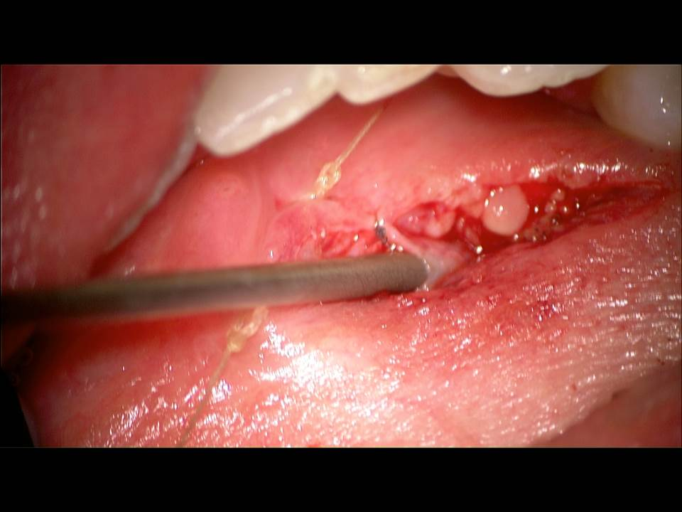

Slide 26
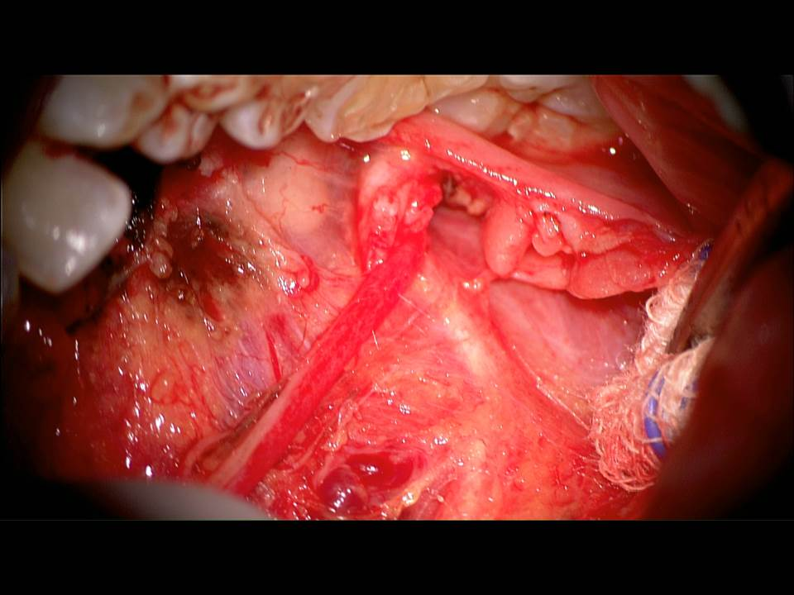

Slide 27
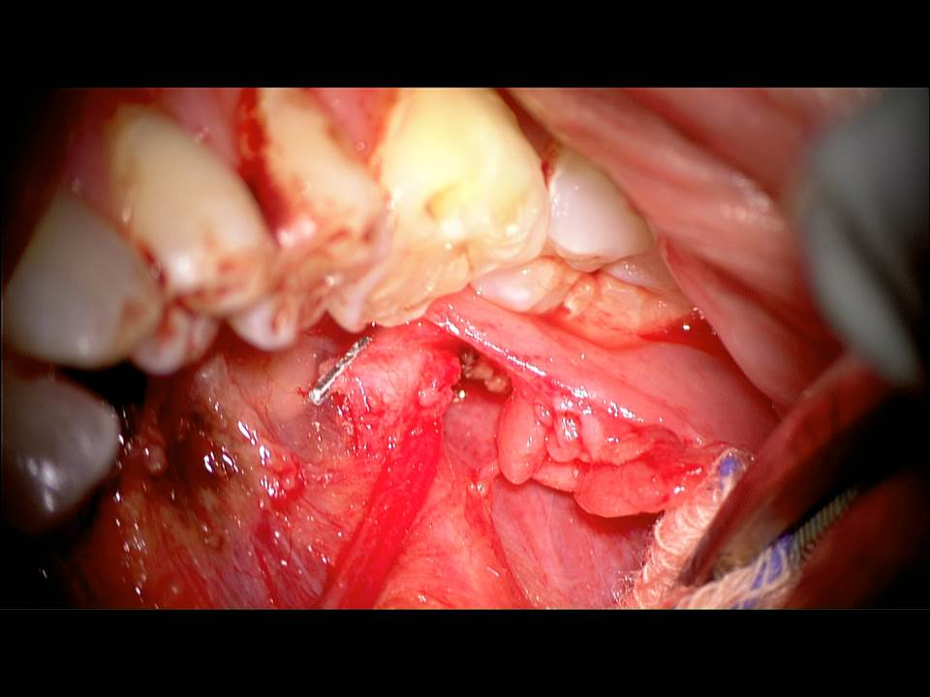

Slide 28
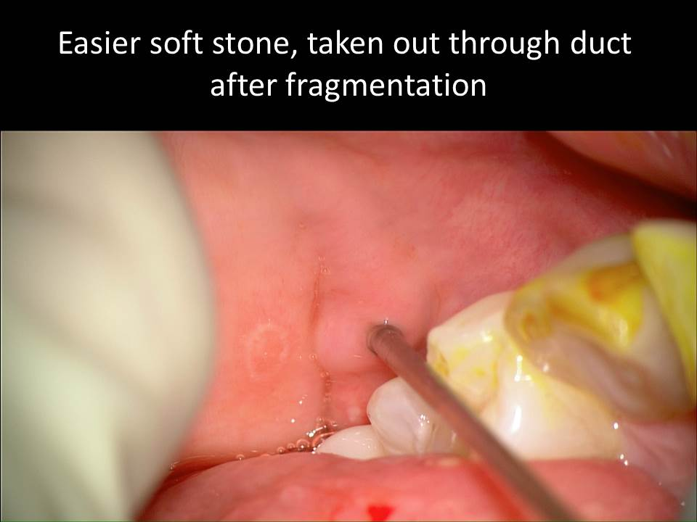

Slide 29
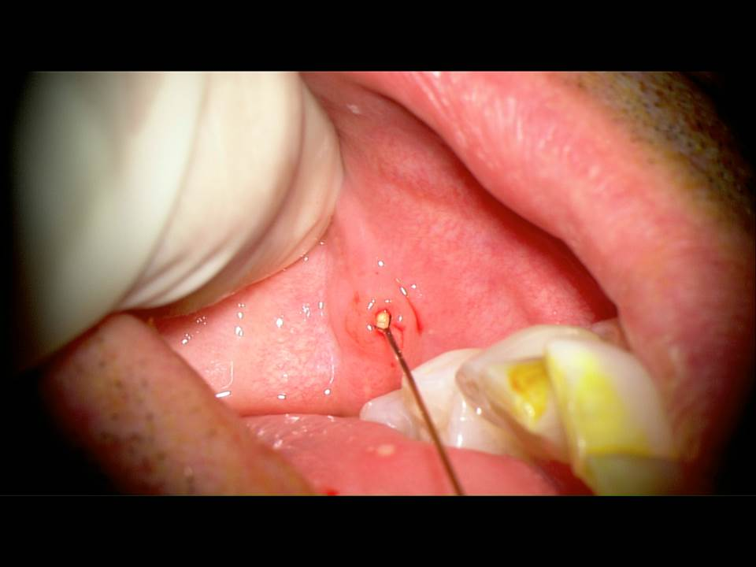
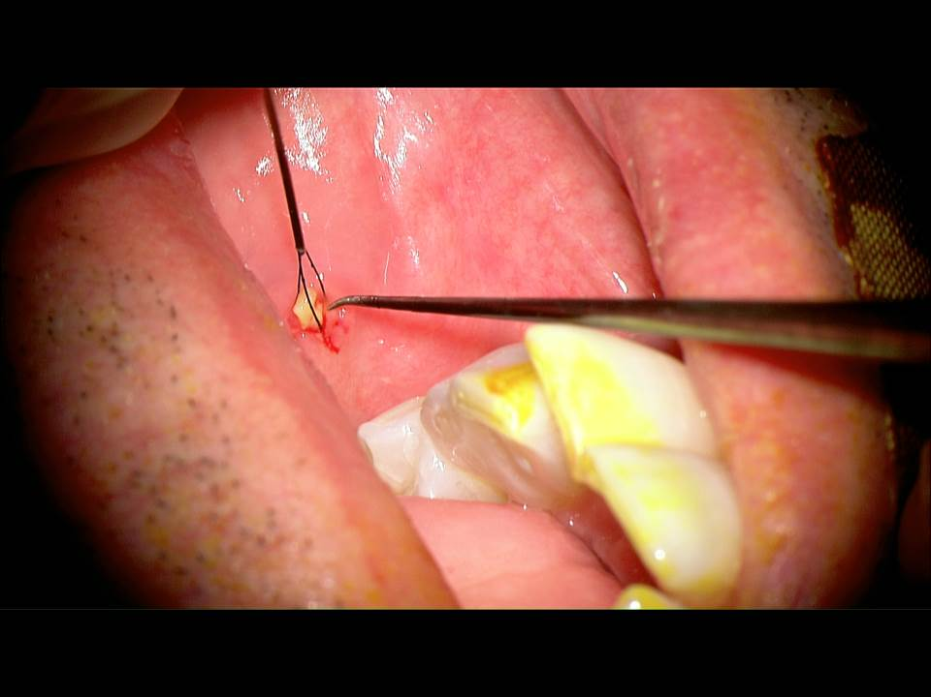

Slide 30
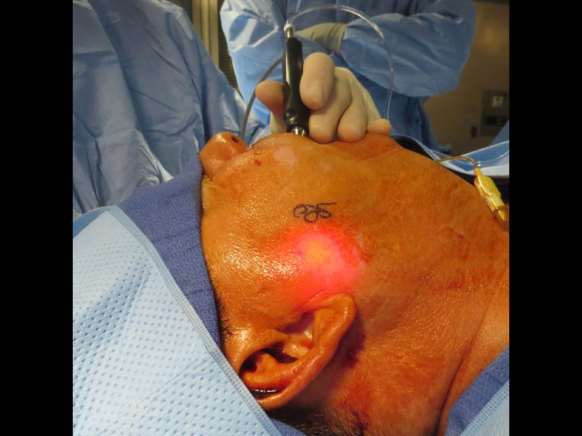

Slide 31
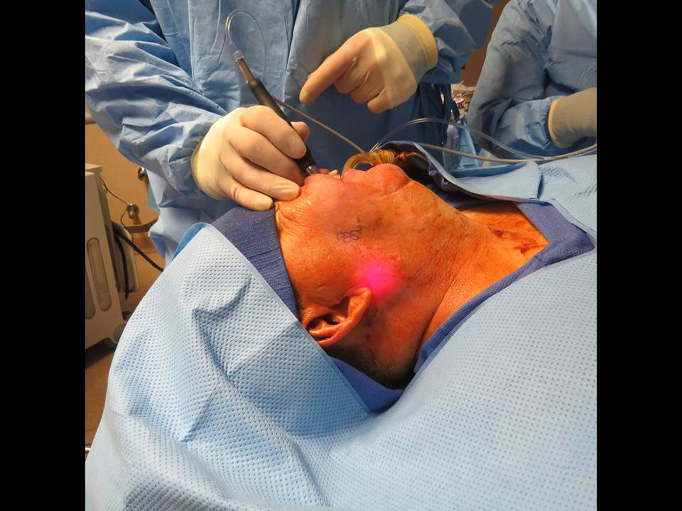

Slide 32
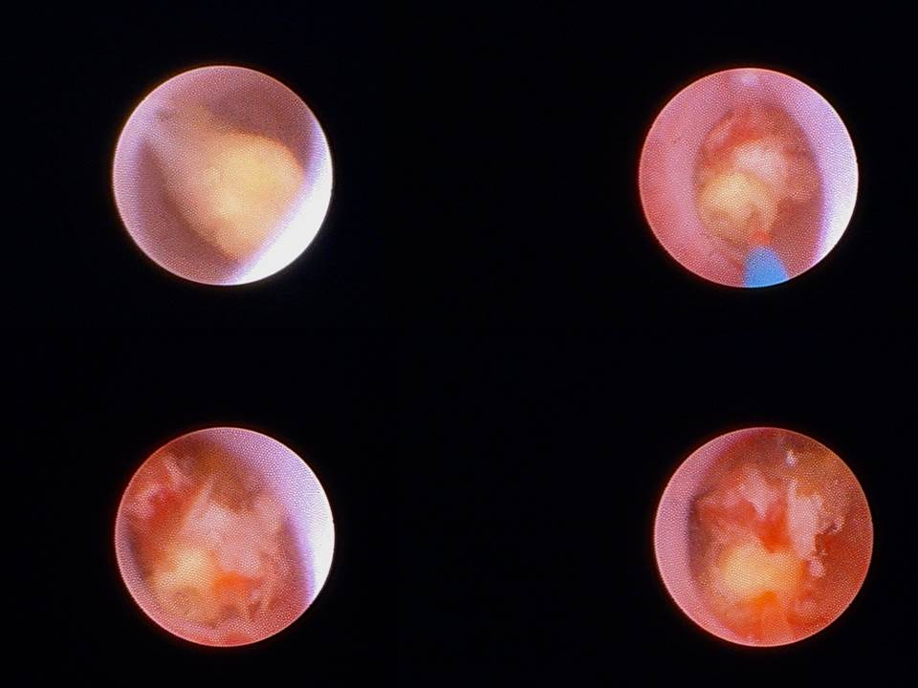

Slide 33
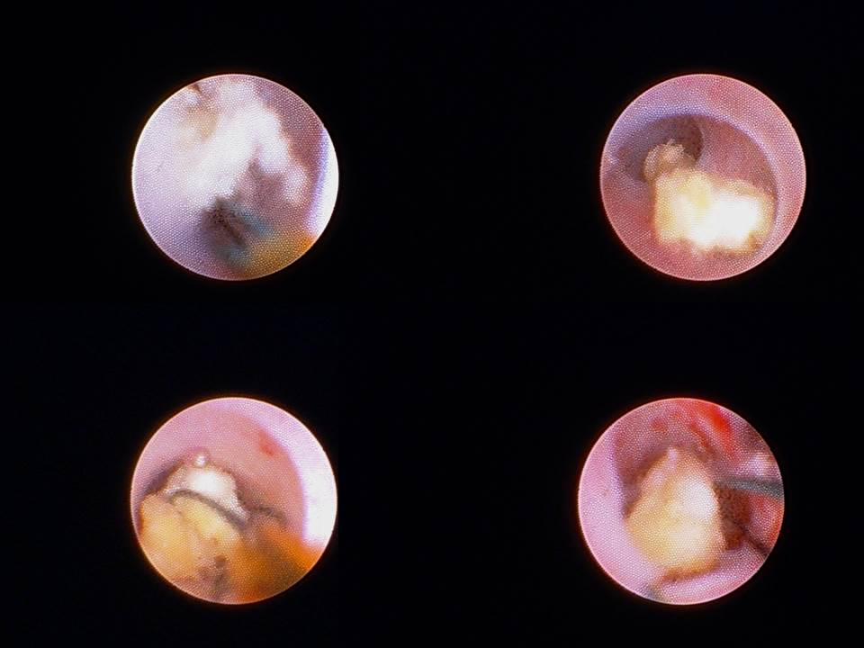

Slide 34
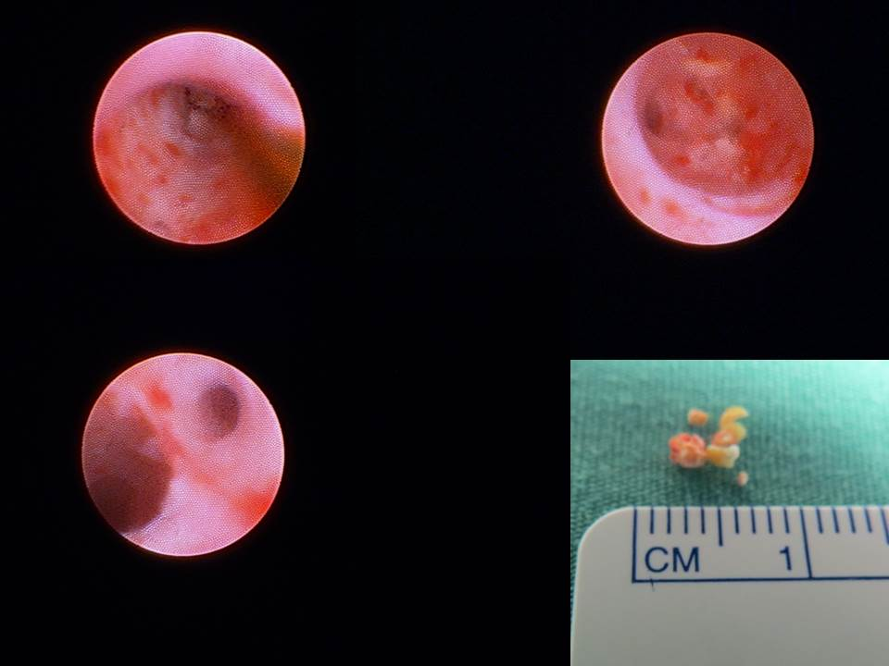

Slide 35

Lab
Simulation Model
Cadaver Dissection

Slide 36
Lab
Simulation Model
Cadaver Dissection
Submandibular duct (Wharton’s duct) cannulation
dilation, sialendoscopy
Identify duct through floor of mouth incision
sialendoscopy through FOM duct incision
Identify lingual nerve
Remove sublingual gland
Dissect duct to hilum
* extra points: identify submandibular ganglion
Ann Otol Rhinol Laryngol. 2015 May;124(5):341-4. doi: 10.1177/0003489414557019. Epub 2014 Nov 25.
Transoral submandibular ganglion neurectomy: an anatomical feasibility study.
Spock T¹, Hoffman HT², Joshi AS³.

